Slide 1
The Financial Cost of Childcare

Slide 2
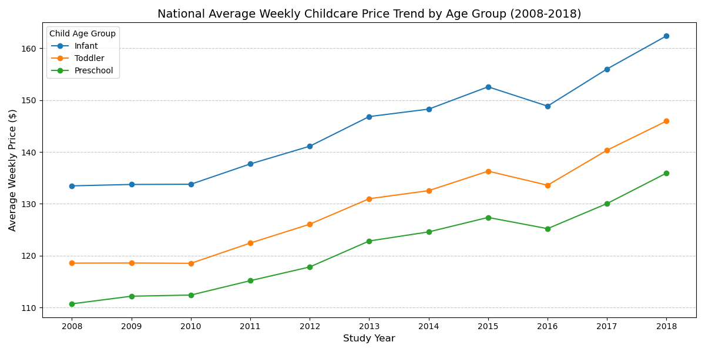
Rising Costs over a Decade (2008 – 2018)
The data shows that cost is maintained and increases year to year throughout the decade with infant care being the most expensive, followed by Toddler care and finally Preschool care.

Slide 3
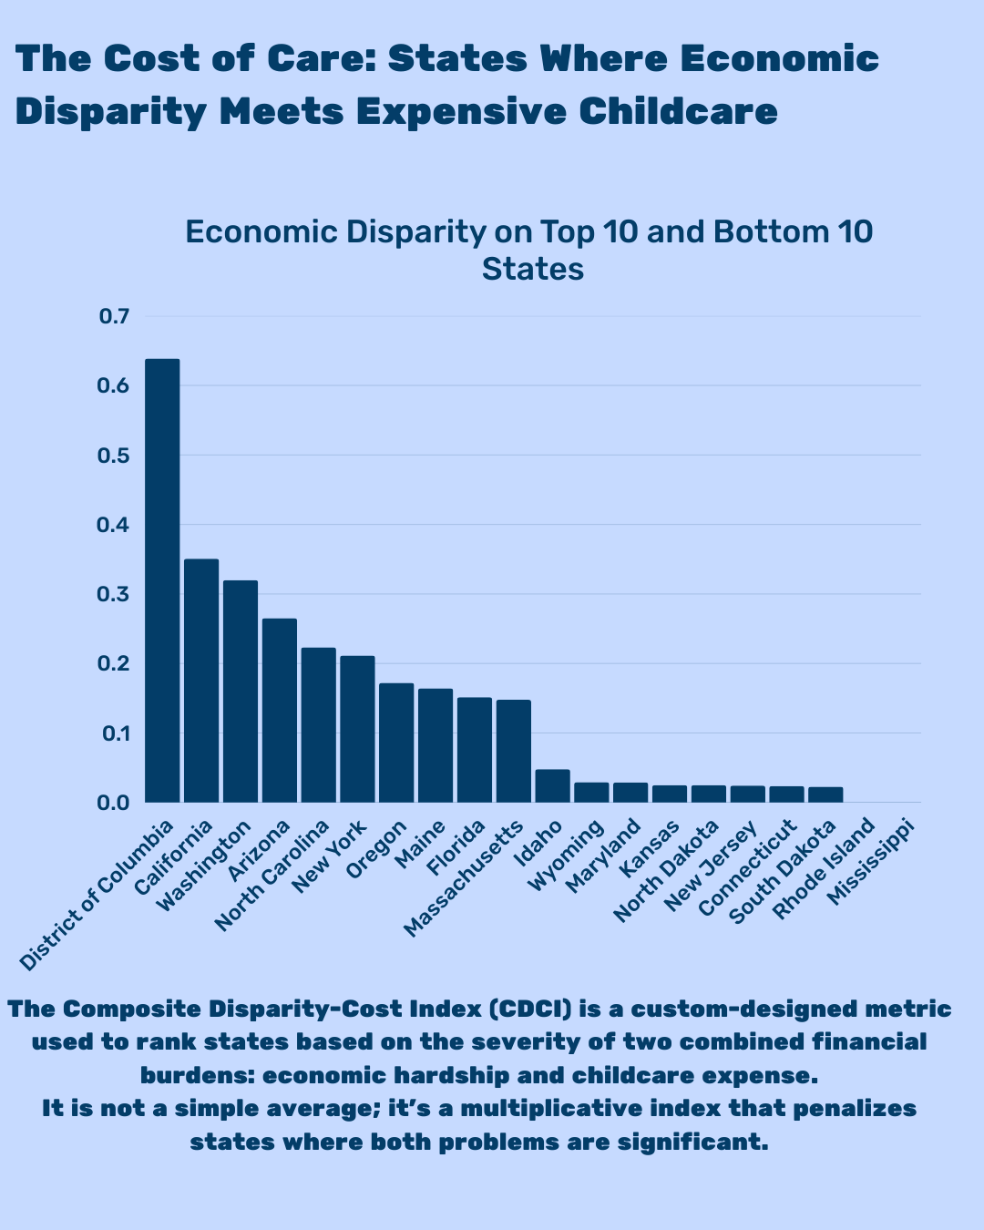
Cost Disparity Between States

Slide 4
Summary
The reports show that childcare is increasing every year and the burden to new parents are ever increasing.
The location has a profound impact on childcare cost. Mississippi was one of the lowest CDC compared to California.
The information can provide parents with better understanding where to raise their children.
The charts also can inform young marriage couples about the importance of economics in their areas and how to plan for future children.

Slide 5
Thank you
Nels Findley

